Slide 1
UKG Ready: Employee Training
UKG Ready Training
Notes:
Note to developers: If you prefer one of the other title slides, right click and select Layout. Then select the title slide you prefer.

Slide 2
Getting Started
Notes:
TOPIC TRANSITION SLIDE – Use to introduce a topic
**Introduce topic and set expectations of what is covered in the topic.
------------- Sample Instructor Script----------
Discussion: When you think of earnings, what types of earnings come to mind that employee’s might be paid?
Earnings codes are an essential building block in our payroll processing – they are used to differentiate the different types of earnings.
DEMO: Can demo Jury duty and then go over car allowance setup,
(Company Settings > Payroll Setup > Earnings Codes - 2 methods to add…what do you think they are? (add new and clone_
- Learner Guide exercises begin on Pg 10)
Learner Guide Exercise 1 add new earnings code for Car allowance.
Learner Guide Exercise 2 (on your own) create or clone Expense Reimbursements earnings code
Learner Guide Exercise 3 (optional) Create a new earning code for Leave of Absence
Add’l examples - Jury Duty – Bereavement – Severance
(Pg 283 in user guide)

Slide 3
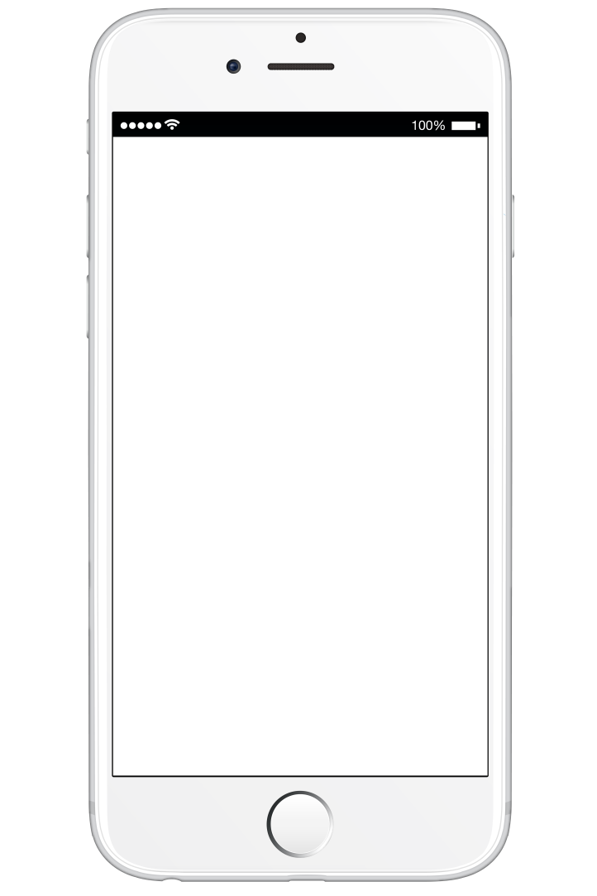
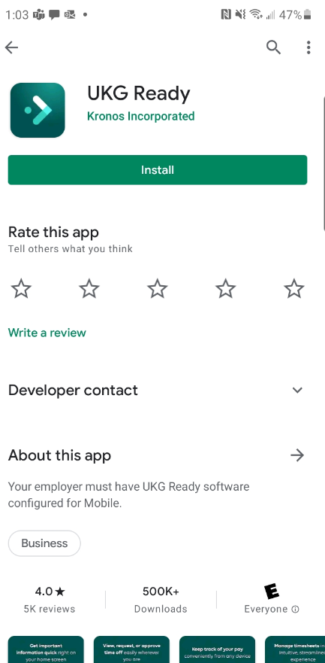
Mobile App and Login Info
Documentation for this has already been provided to employees from Sharon and Barb. Please refer to those instructions.

Slide 4
Employee Common Tasks
Notes:
TOPIC TRANSITION SLIDE – Use to introduce a topic
**Introduce topic and set expectations of what is covered in the topic.
------------- Sample Instructor Script----------
Discussion: When you think of earnings, what types of earnings come to mind that employee’s might be paid?
Earnings codes are an essential building block in our payroll processing – they are used to differentiate the different types of earnings.
DEMO: Can demo Jury duty and then go over car allowance setup,
(Company Settings > Payroll Setup > Earnings Codes - 2 methods to add…what do you think they are? (add new and clone_
- Learner Guide exercises begin on Pg 10)
Learner Guide Exercise 1 add new earnings code for Car allowance.
Learner Guide Exercise 2 (on your own) create or clone Expense Reimbursements earnings code
Learner Guide Exercise 3 (optional) Create a new earning code for Leave of Absence
Add’l examples - Jury Duty – Bereavement – Severance
(Pg 283 in user guide)

Slide 5
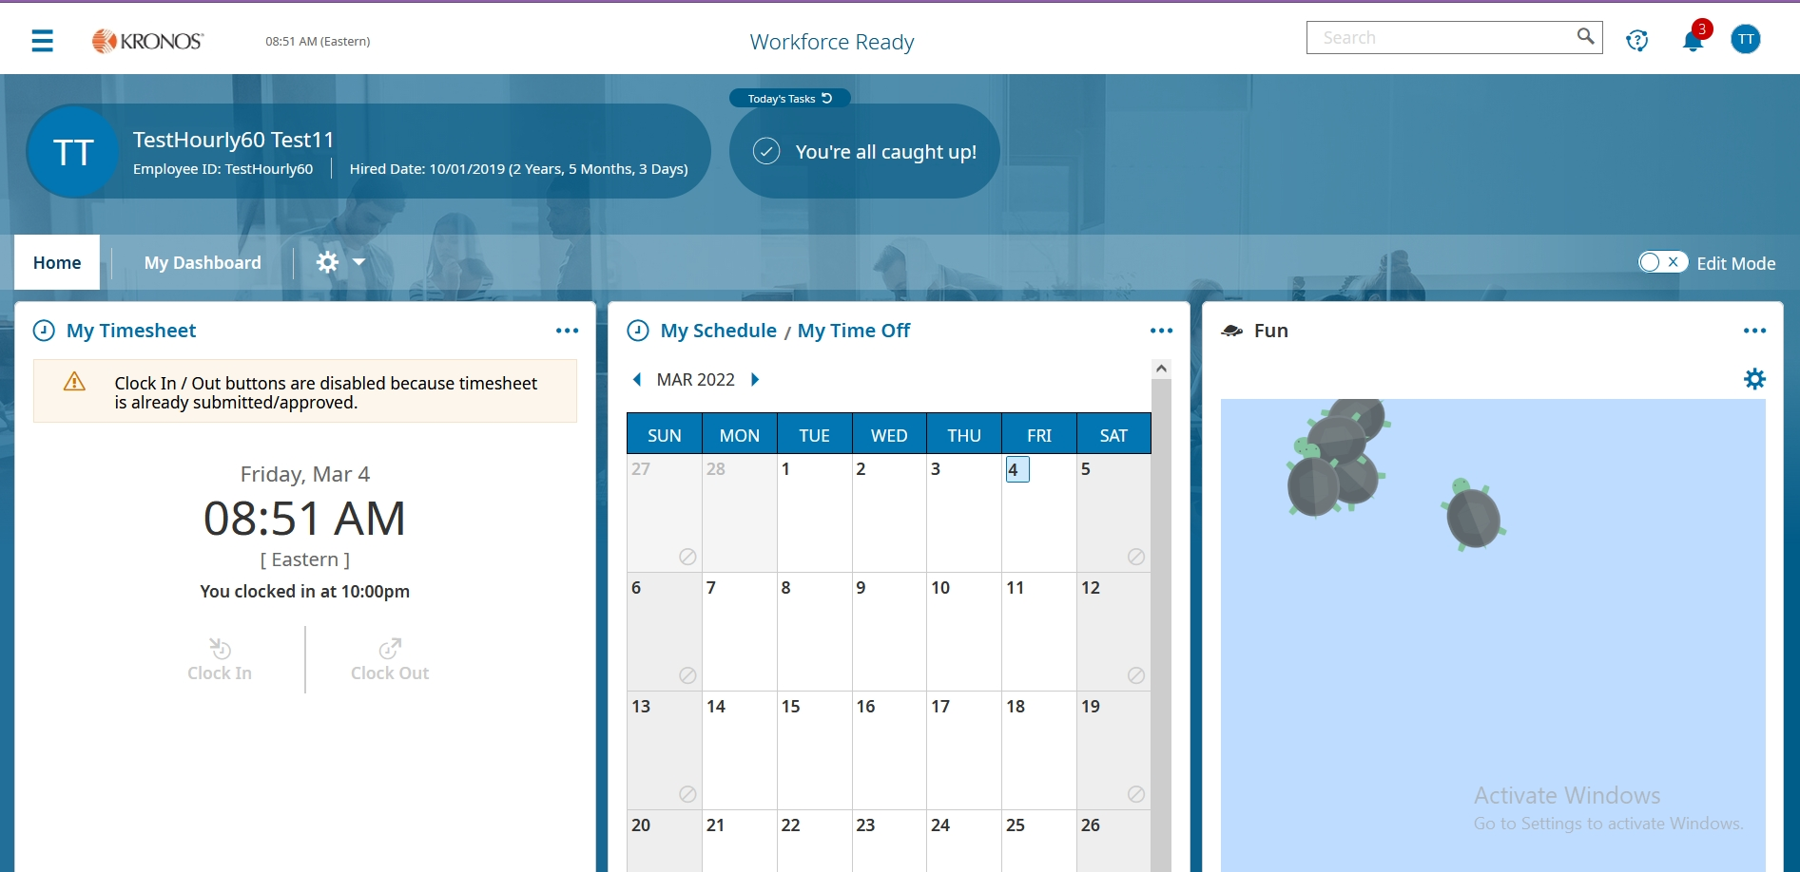
Employee Dashboard Upon Logging In

Slide 6
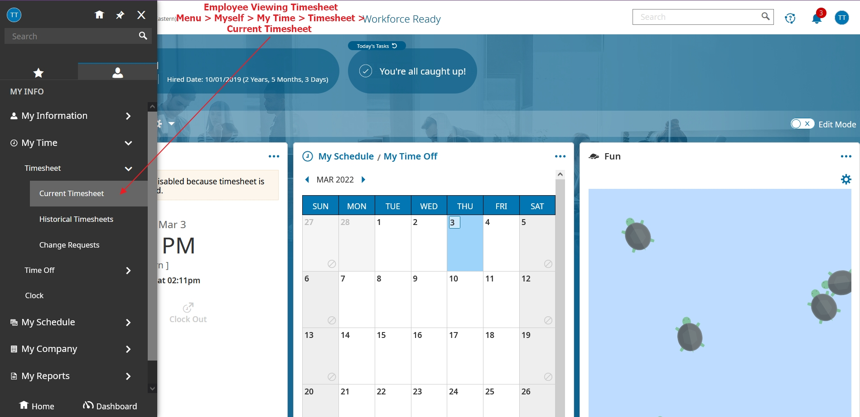
Viewing Your Timesheet From Menu

Slide 7
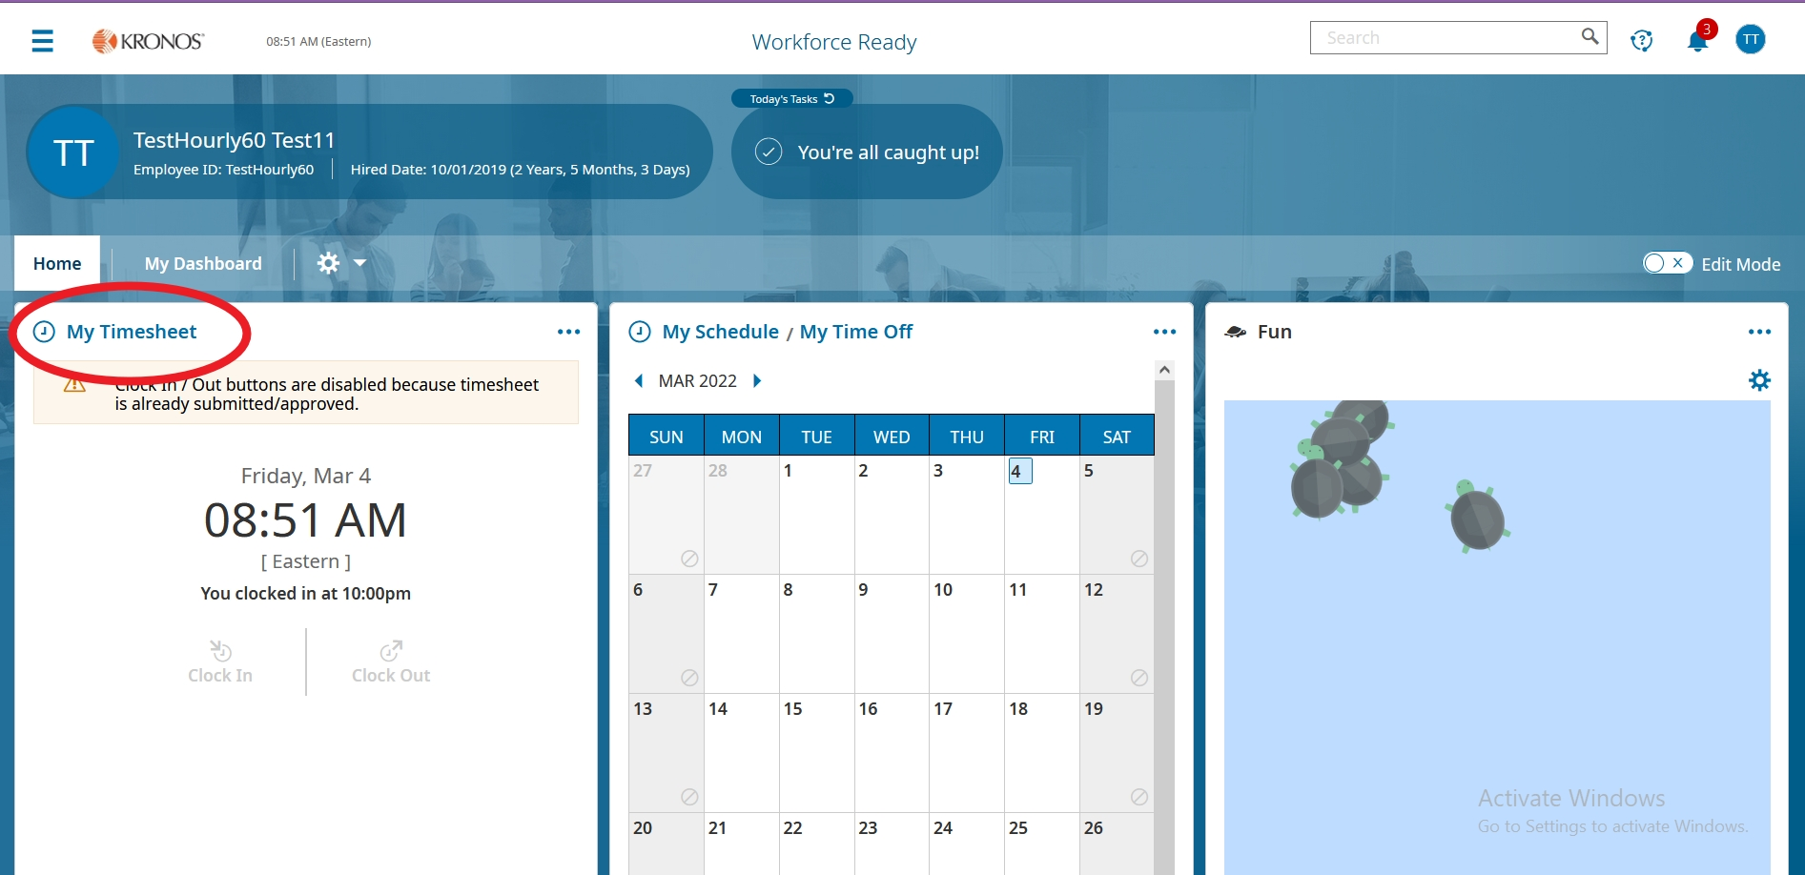
Viewing Your Timesheet From Dashboard

Slide 8
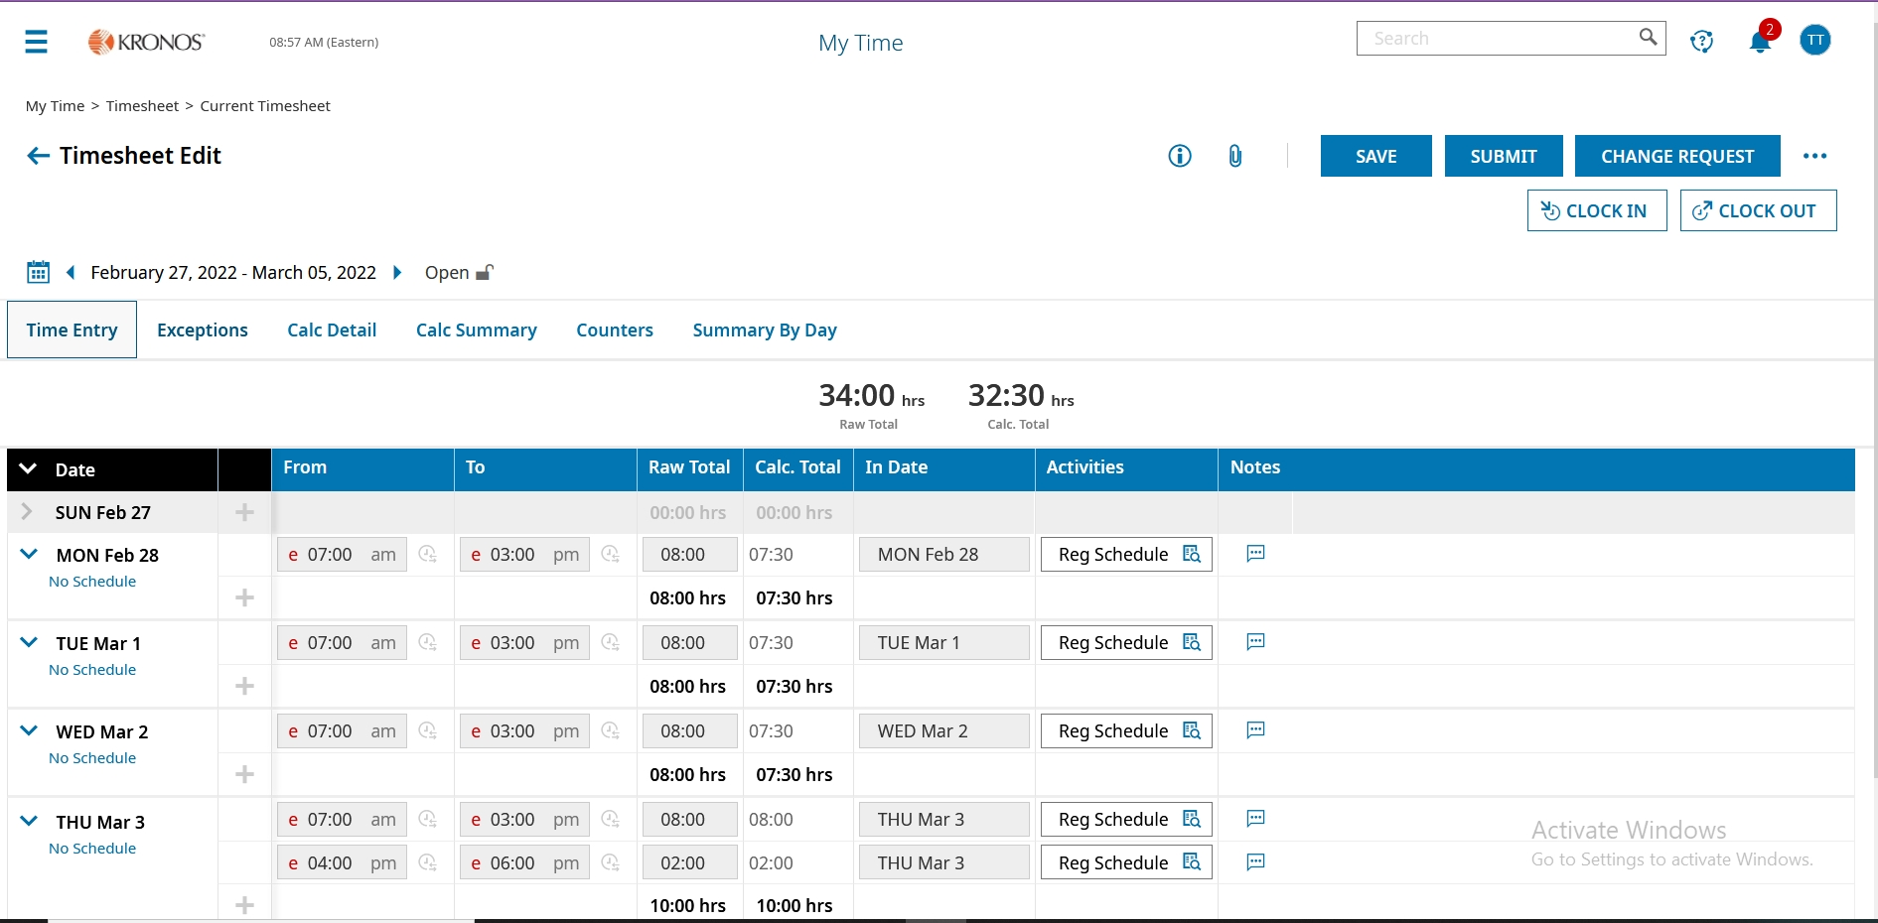
Timesheet

Slide 9
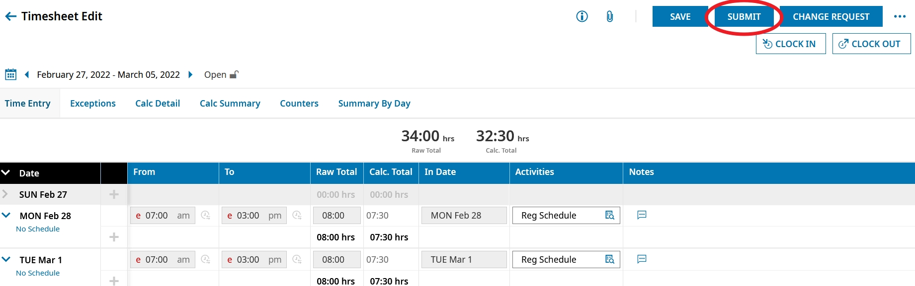
Submitting Your Timesheet
Make any corrections to your timesheet and then Submit.

Slide 10
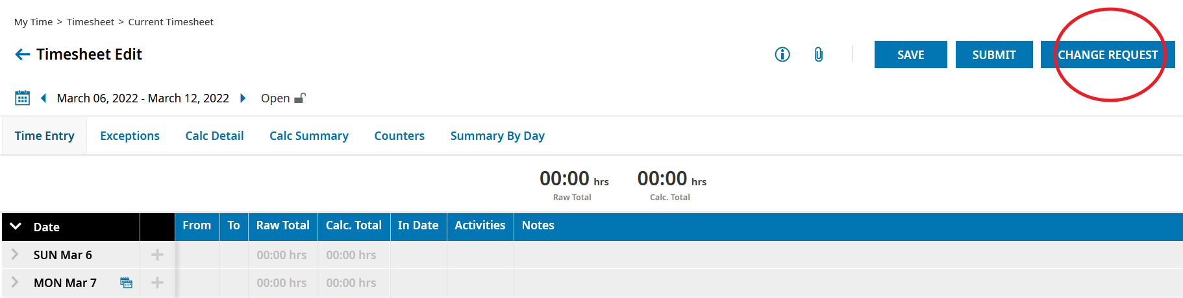
Requesting a Change to Your Timesheet
If you need to make a change to the timesheet, select Change Request.

Slide 11
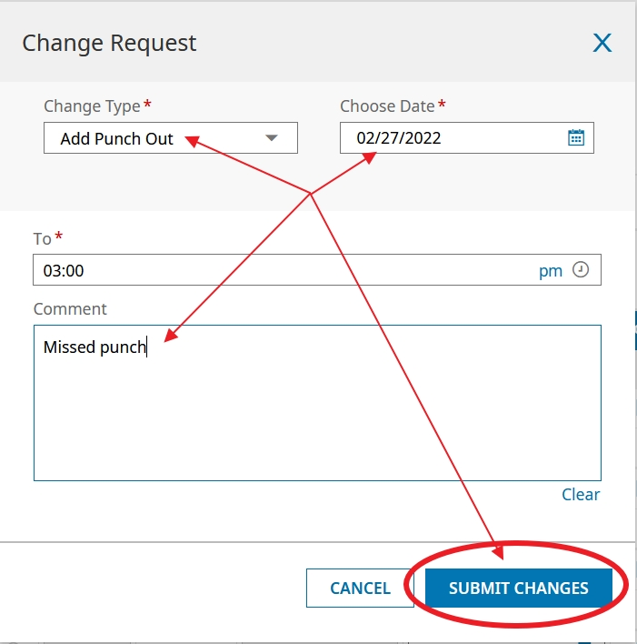
Requesting a Change to Your Timesheet
Fill out all boxes with red asterix. Then Submit changes. This sends it to manager to be approved.

Slide 12
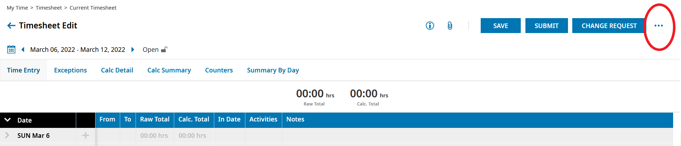
1. Request Time Off From Timesheet
There are a few different ways to request Time Off.

Slide 13
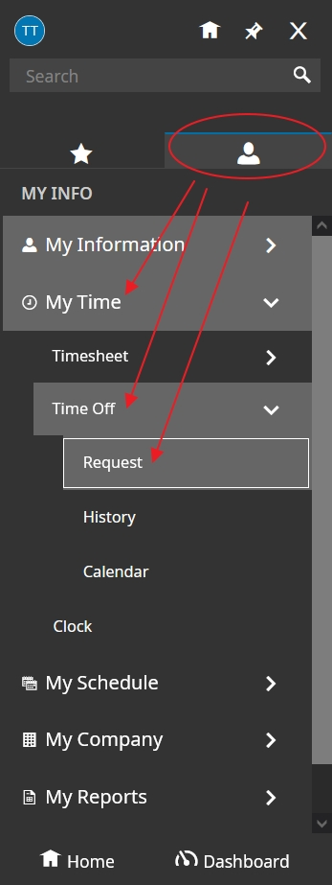
2. Submitting a Time Off Request From Menu

Slide 14
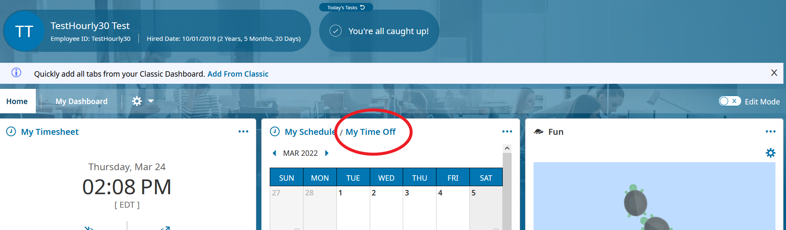
3. Dashboard: Request Time Off

Slide 15
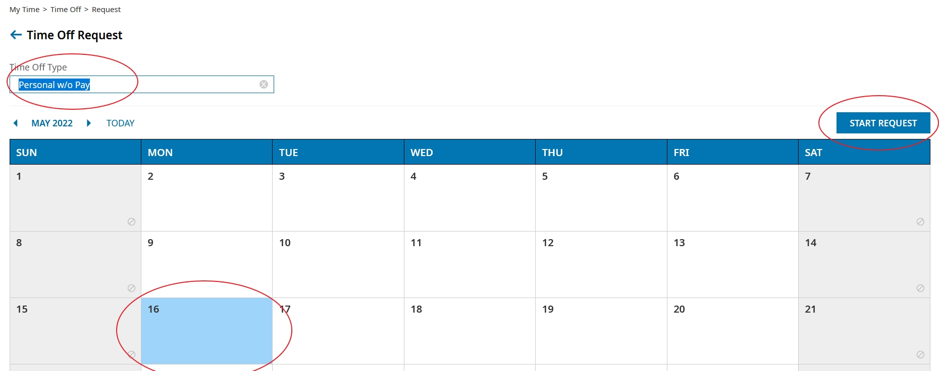
4. Dashboard Calendar Request Time Off

Slide 16
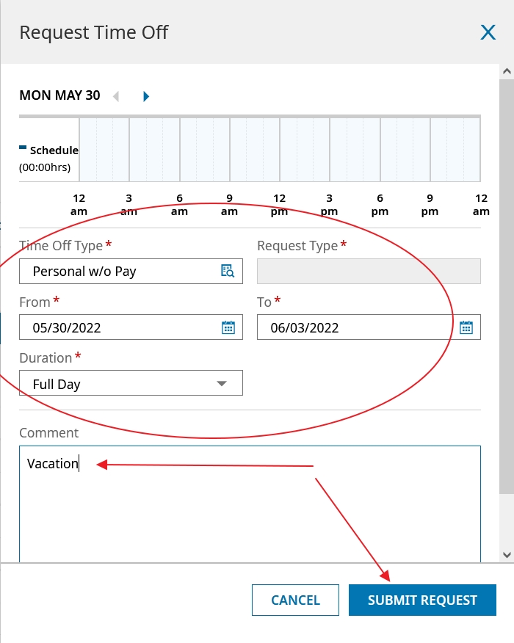
Submit a Time Off Request
Fill out boxes with red asterix and then Submit Request. This sends request to management.

Slide 17
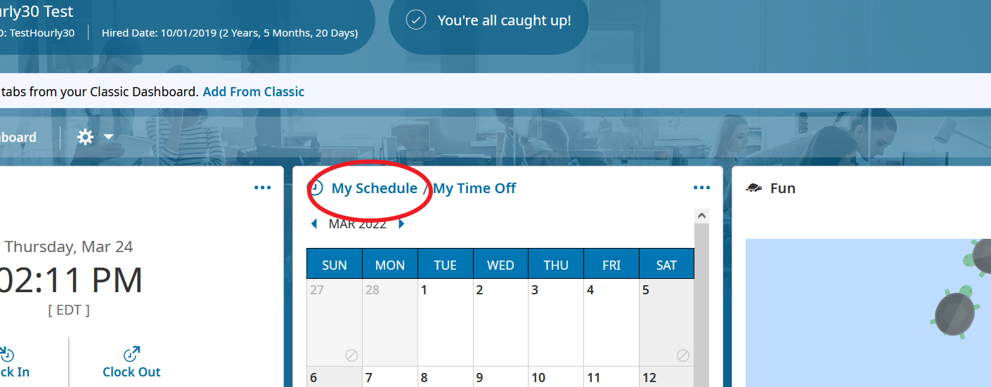
Viewing Your Schedule From Dashboard

Slide 18
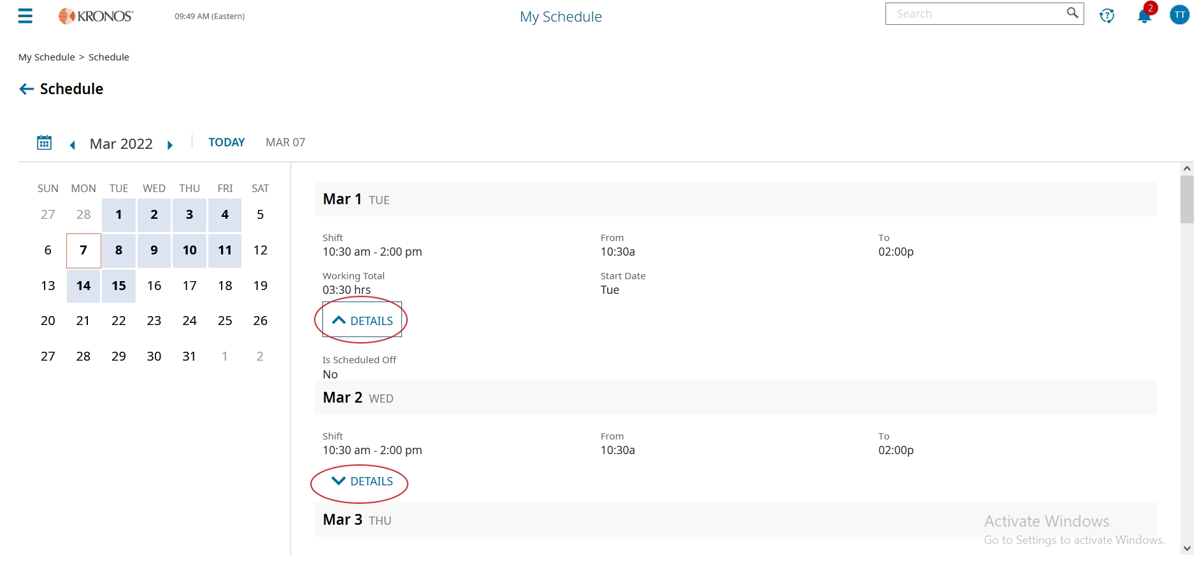
Viewing Your Schedule
You can click the arrow for more or less details

Slide 19
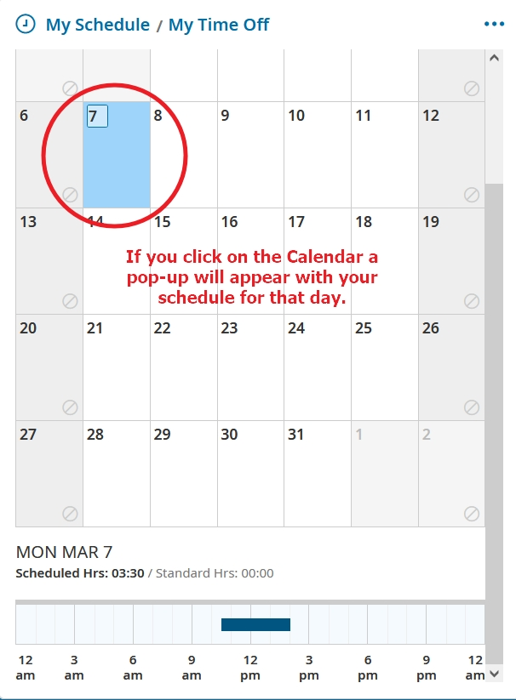
Viewing Your Schedule
Click on 1 day of the calendar for a quick glance

Slide 20
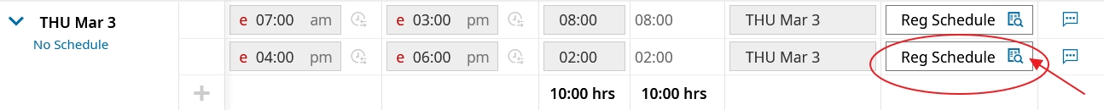
Changing Cost Center From the Timesheet
Can use this for extra duties

Slide 21
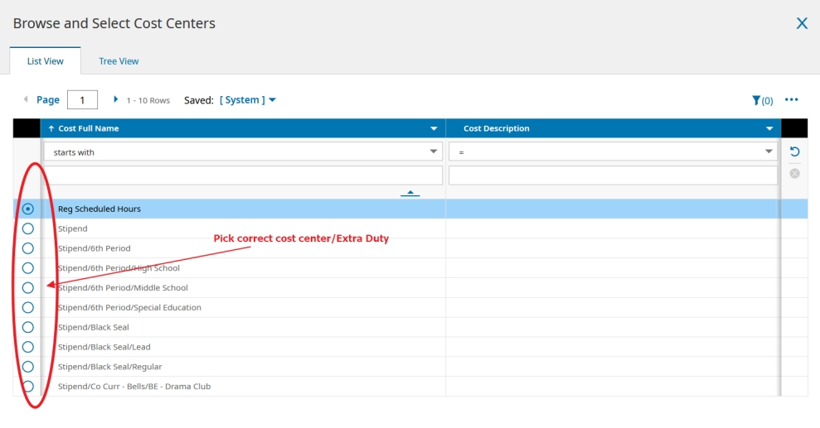
Changing Cost Center
Select the Cost Center needed.

Slide 22
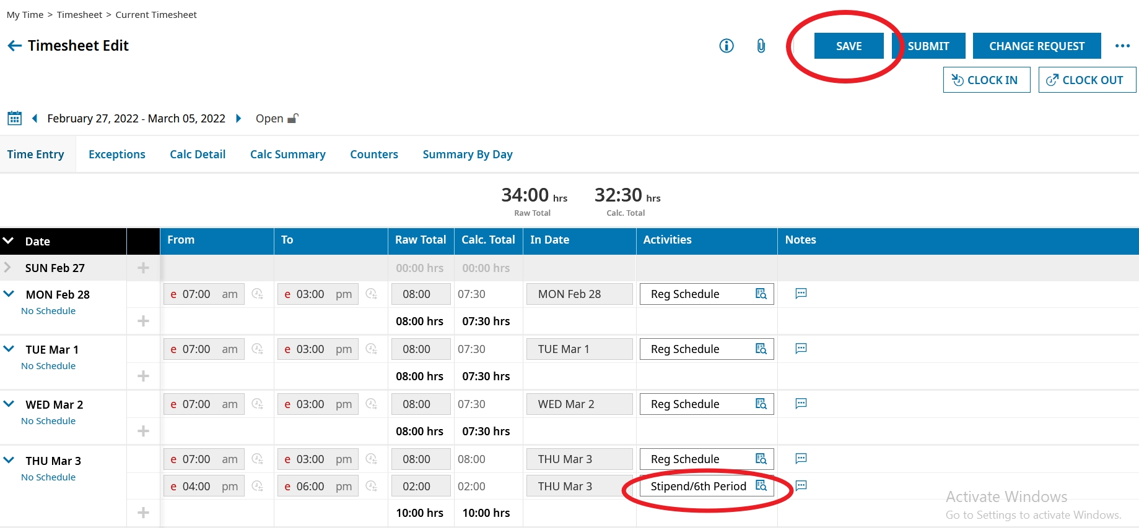
Changing Cost Centers From Timesheet
After you selected the correct cost center change, click SAVE.

Slide 23
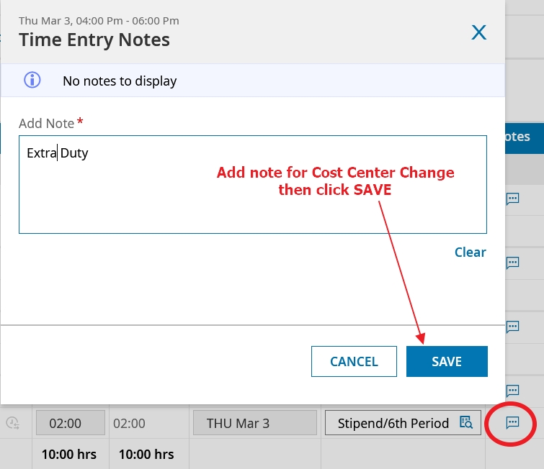
Using the Notes field for Cost Center Change
If needed include note explaining cost center change.

Slide 24
Manager Common Tasks
Notes:
TOPIC TRANSITION SLIDE – Use to introduce a topic
**Introduce topic and set expectations of what is covered in the topic.
------------- Sample Instructor Script----------
Discussion: When you think of earnings, what types of earnings come to mind that employee’s might be paid?
Earnings codes are an essential building block in our payroll processing – they are used to differentiate the different types of earnings.
DEMO: Can demo Jury duty and then go over car allowance setup,
(Company Settings > Payroll Setup > Earnings Codes - 2 methods to add…what do you think they are? (add new and clone_
- Learner Guide exercises begin on Pg 10)
Learner Guide Exercise 1 add new earnings code for Car allowance.
Learner Guide Exercise 2 (on your own) create or clone Expense Reimbursements earnings code
Learner Guide Exercise 3 (optional) Create a new earning code for Leave of Absence
Add’l examples - Jury Duty – Bereavement – Severance
(Pg 283 in user guide)

Slide 25
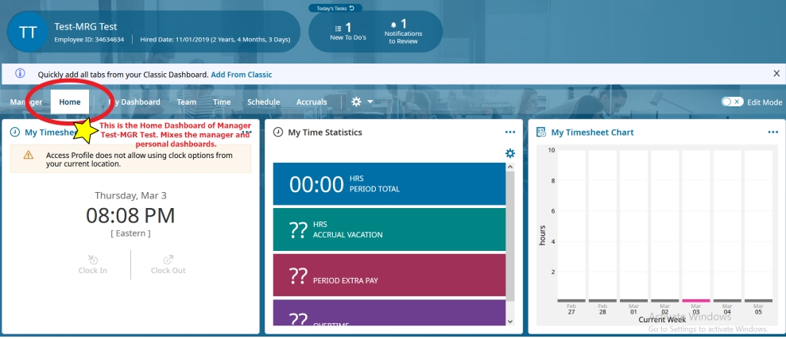
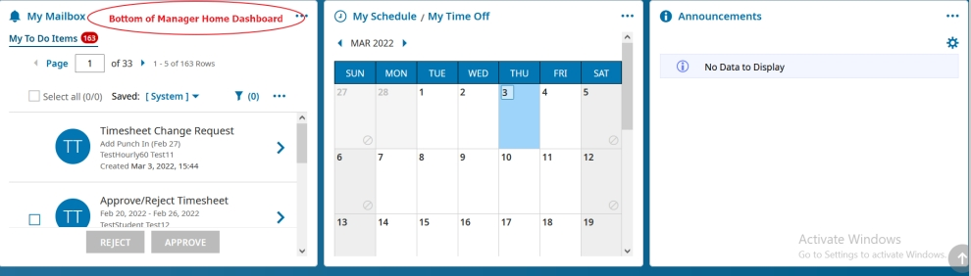
Home Dashboard: Manager and Personal
View of mixed manager and personal dashboards

Slide 26
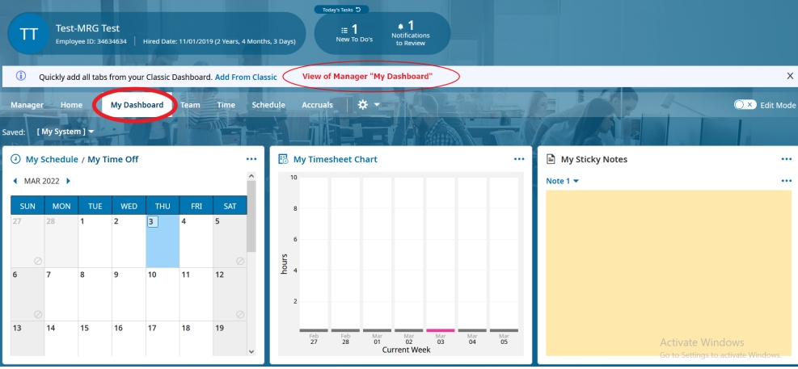
View of Manager: My Dashboard
Personal view without manager duties and To Do items

Slide 27
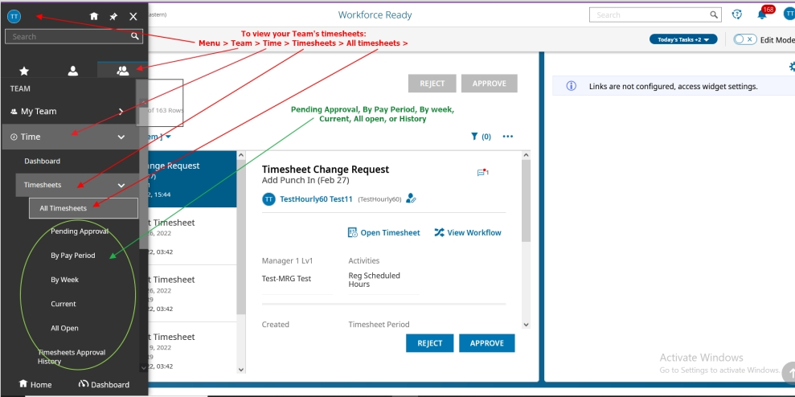
Viewing Your Team’s Timesheets

Slide 28
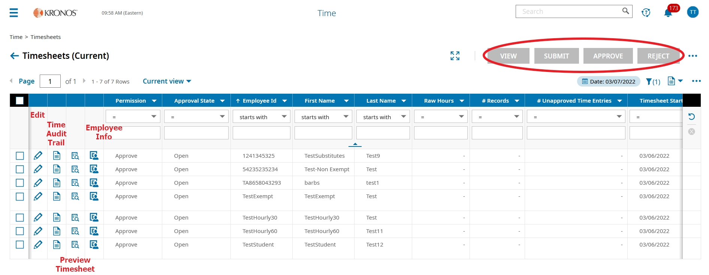
Viewing Your Team’s Timesheets
Here is where the Manager can View, Change, Submit, Approve, or Reject Timesheets

Slide 29
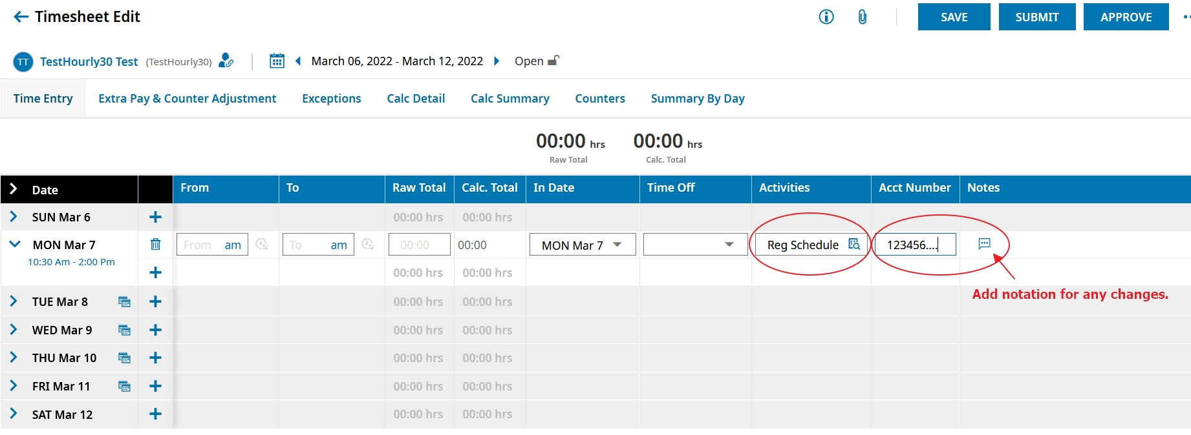
Editing an Employee’s Timesheet
Manager can change Cost Center here for Extra Duties and add notes if needed.

Slide 30
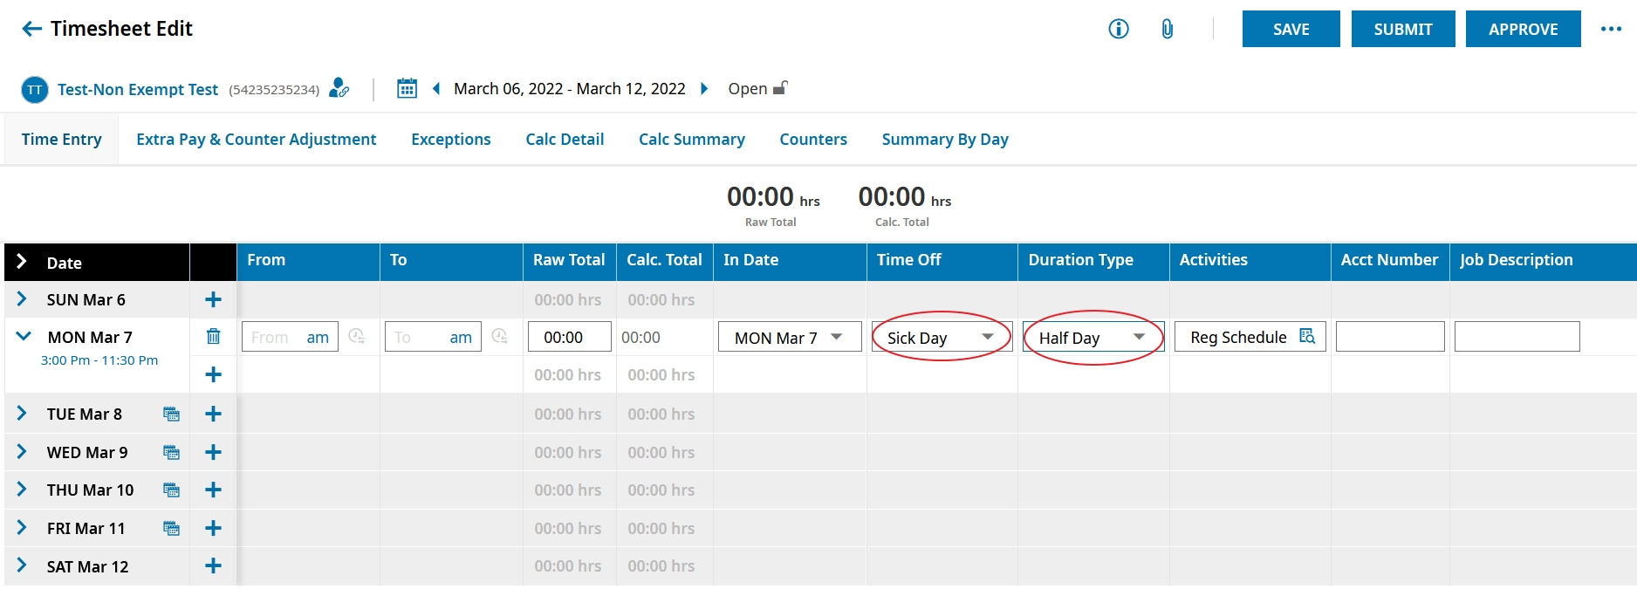
Editing an Employee’s Timesheet
Edit Timesheet for sick day etc. and choose how much time

Slide 31
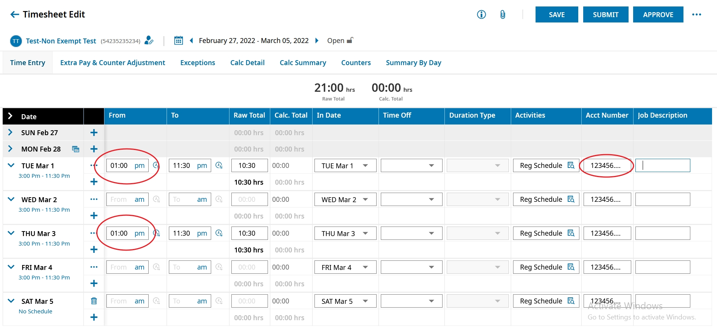
Viewing and Editing an Employee’s Time
Edit the Punches on the Employee’s Time sheet

Slide 32
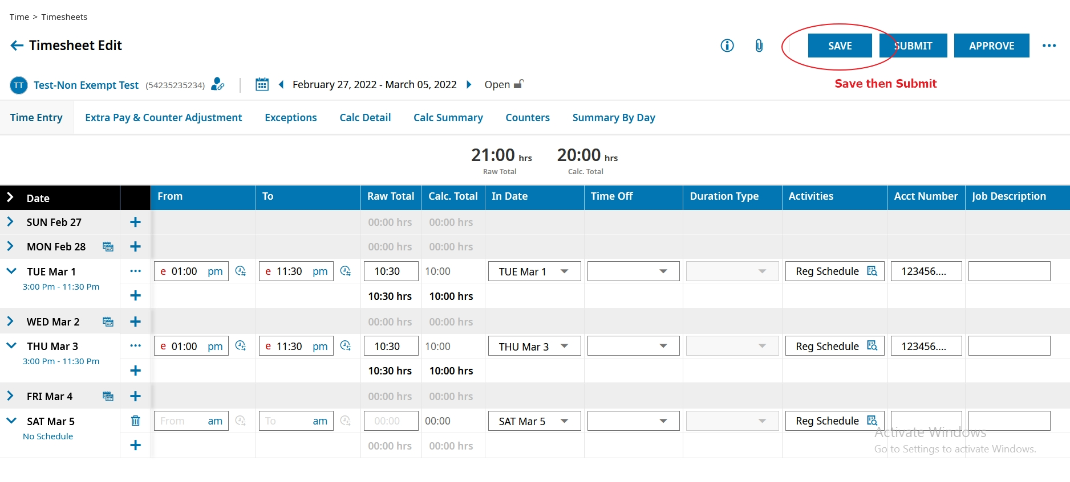
Viewing and Editing an Employee’s Time
After Timesheet is edited then it needs to be SAVED

Slide 33
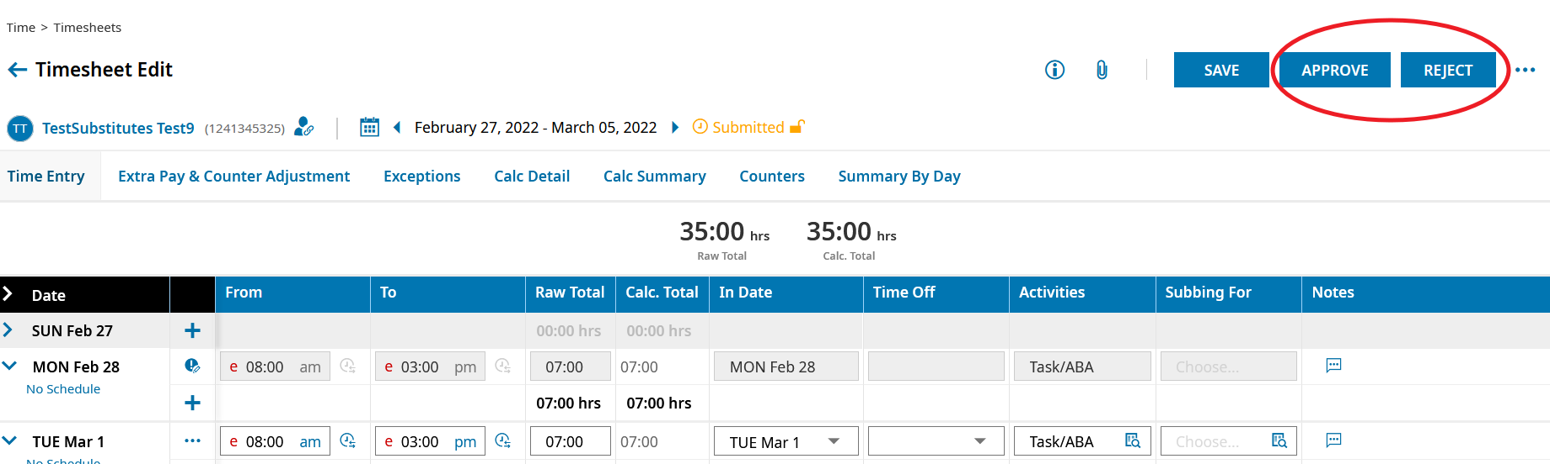
Viewing and Editing an Employee’s Time
After Timesheet is saved, then need to Approve/Reject

Slide 34
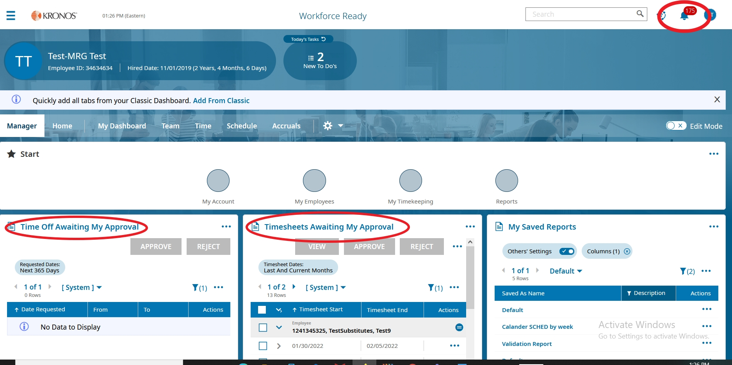
Approving Employee Requests and To Do Items

Slide 35
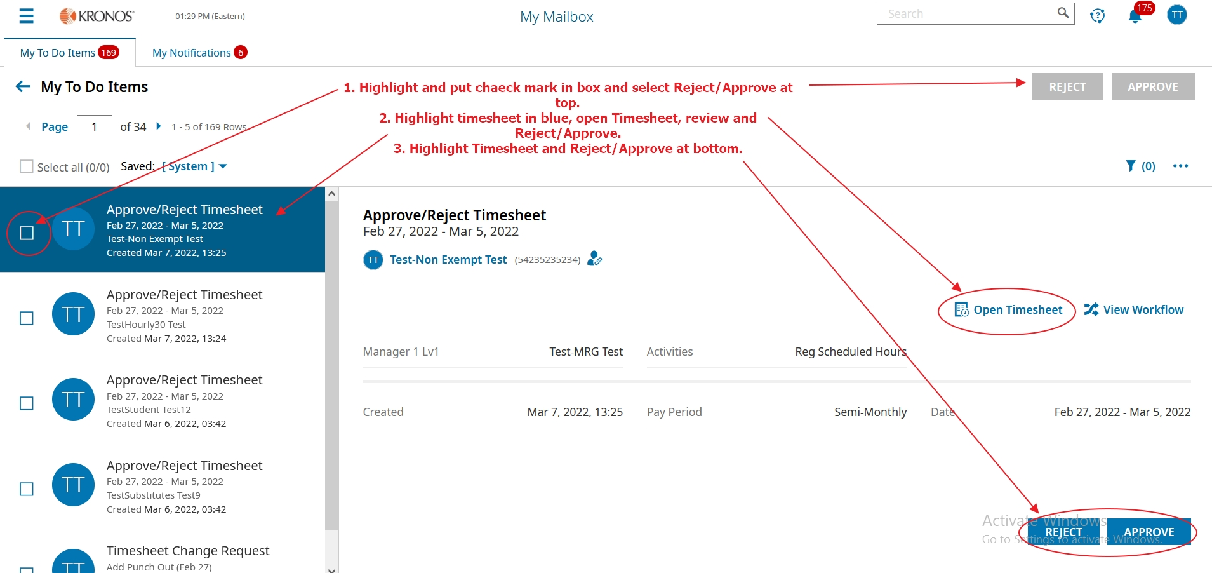
Approving Employee Requests and To Do Items
From the Manager/Home Dashboard, click on the Blue hyperlink for My Mailbox. This will bring up your To Do Items.

Slide 36

Approving Employee Requests and To Do Items
Managers can Approve, Reject, and open Timesheets from the ToDo Items

Slide 37
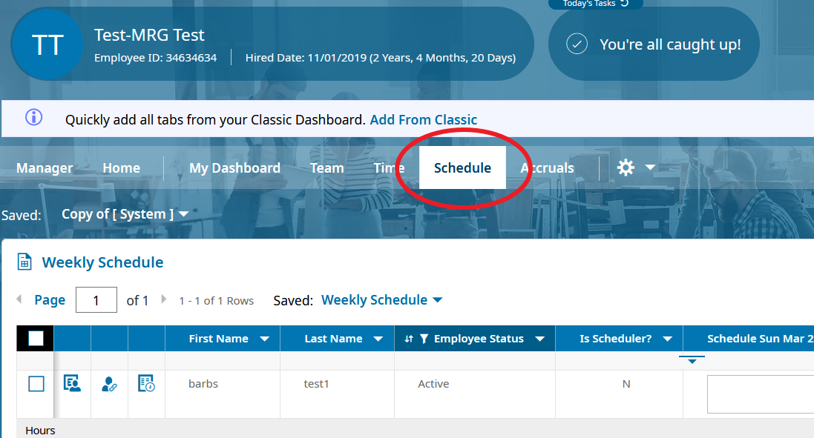
View Employee Schedules
Click on Schedule from the Dashboard

Slide 38
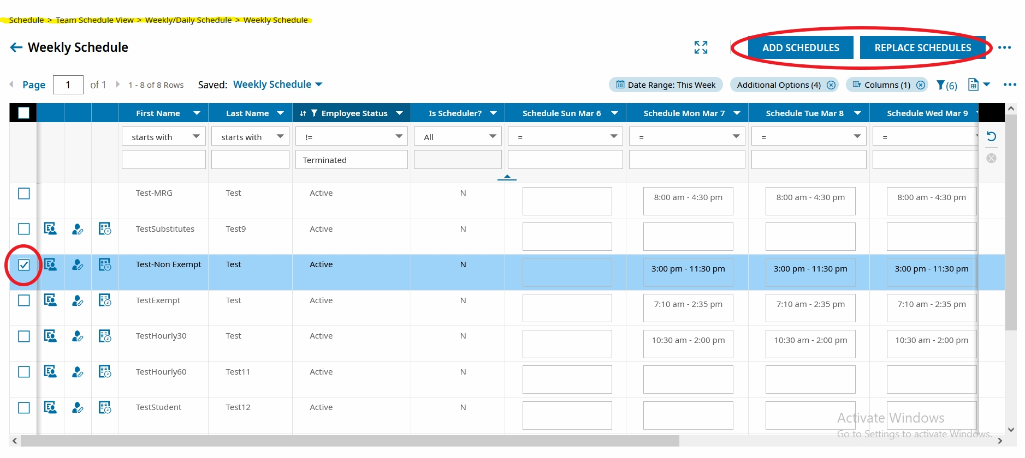
Viewing and Editing Employee Schedules
Can also reach through the Menu: Team>Schedule>Team Schedule View>Weekly/Daily Schedule

Slide 39
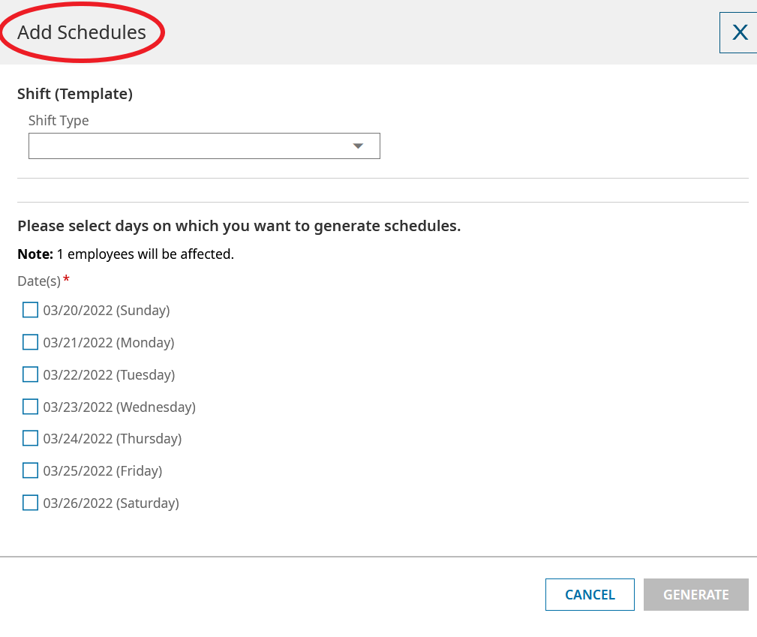
Viewing and Editing Employee Schedules

Slide 40
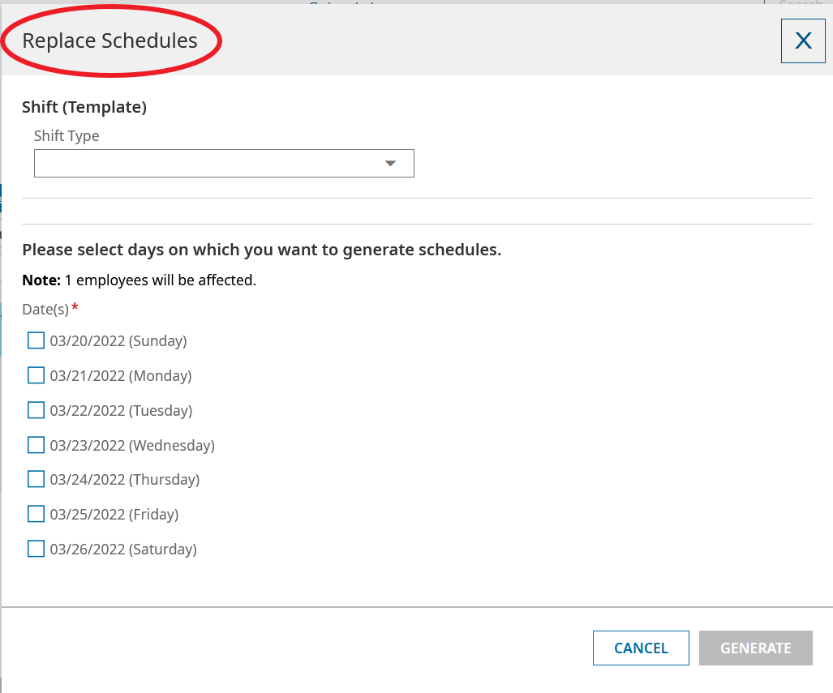
Viewing and Editing Employee Schedules

Slide 41
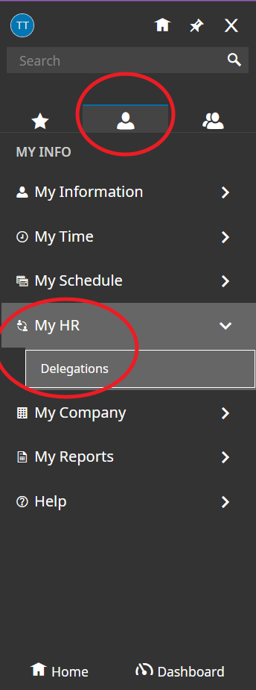
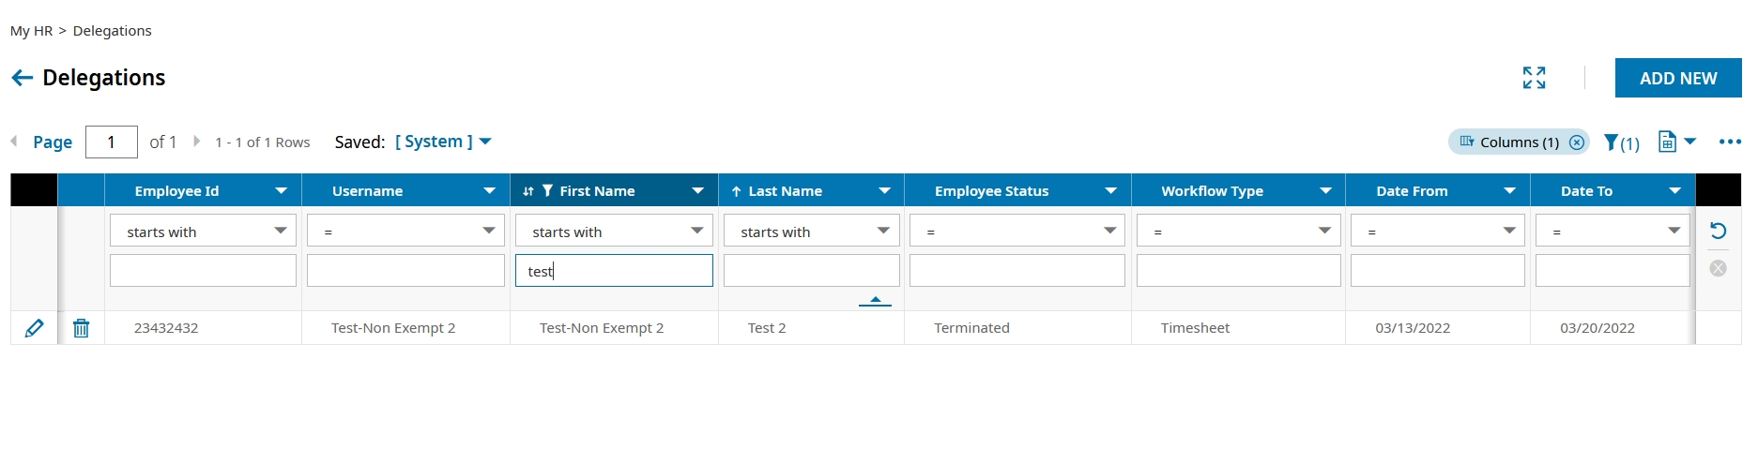
Delegating Approval Tasks
Go to the Menu>Single Person Icon>My HR>Delegations. Can edit employee listed or Add New.

Slide 42
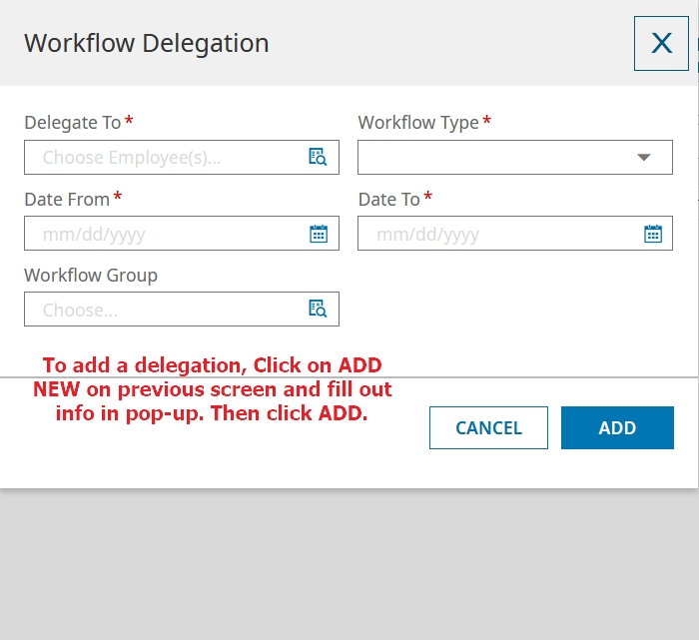
Delegating Approval Tasks
Fill out pop-up and click ADD.

Slide 43
Final Questions
Notes:
QUESTIONS SLIDE

